Slide 1
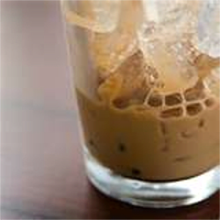
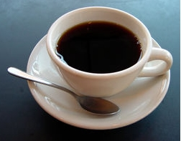
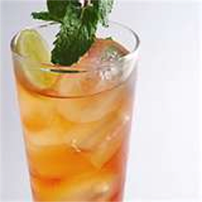
(Under 12 years old only)
Including a kid-sized soft-drink or milk
KID1. Phở Chín 4.99
Noodle soup and brisket meat
KID2. Phở Bò Viên 4.99
Noodle soup and meatball
KID3. Phở Tái Bầm 4.99
Noodle soup and eye of round
KID4. Cơm Thịt Nướng 4.99
Steamed rice and BBQ pork
KID5. Cơm Gà Nướng 4.99
Steamed rice with grilled chicken
KID6. Cơm Tôm Nướng 4.99
Golden rice with shrimp skewers
Drink – Giai Khat
D1. Café Ðen Nóng 2.99
Hot drip pot coffee
D2. Café Ðen Ðá 2.99
Iced drip-pot coffee
D3. Café Sữa Nóng 2.99
Hot drip-pot coffee with condensed milk
D4. Café Sữa Ðá 2.99
Iced drip-pot coffee with condensed milk
D5. Nước Ngọt 1.65
Soft drink (Coke, Diet Coke, Sprite, Dr.PP, 7 Up, Pepsi)
D6. Ðá Chanh 1.99
Fresh lemonade
D7. Soda Chanh 2.50
Soda lemonade
D8. Trà Ðá Chanh 1.99
Lemon iced tea
D9. Soda Sữa Hột Gà 3.25
Soda shake with egg yolk and
condensed milk
D10. Sữa Ðậu Nành 1.99
Soy bean milk
D11. Xí Muội 1.99
Salty plum drink
D12. Nước Cam Tươi 3.25
Fresh orange juice
D13. Nước Dừa 3.50
Coconut juice with ice
D14. Chanh Muối 1.99
Salty lemonade
D15. Trà Ðá 1.25
Iced tea
D16. Trà Nóng 1.25
Hot tea (pot for 2)
www.PhoEmpire.com

