Slide 1
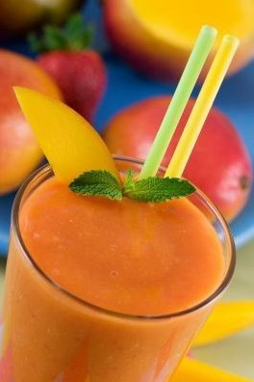
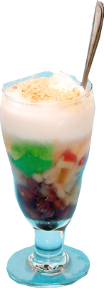
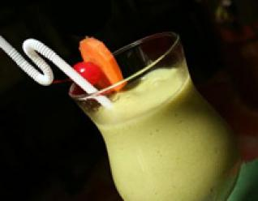
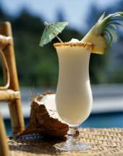
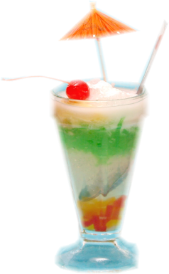
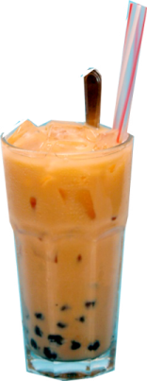
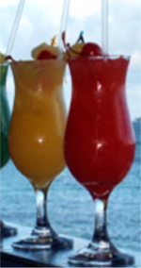
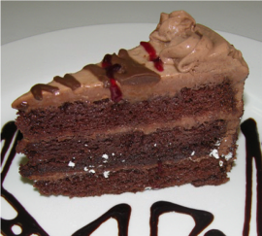
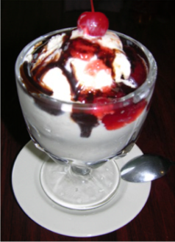
Special
Deserts & Drink
D17. Chè Ðặc Biệt 3.25
Combination bean pudding
A delicious combination of white beans,
red beans, mung bean paste,red tapioca,
green jelly in coconut milk, peanut.
Served with crushed ice.
D18. Chè Ðậu trắng 3.25
White bean , red tapioca, and jelly in coconut milk. Served
with crushed ice.
D19. Chè Ðậu Ðỏ 3.25
Red bean, red tapioca, and jelly in coconut milk. Served with
crushed ice.
D20. Chè Trái Cây 3.25
Jack fruit, longan, palm seed, red tapioca, green jelly in
coconut milk . Served with crushed ice.
D21. Sương Sa Hạt Lựu 3.25
A combination of mung bean paste, jelly,
red and white tapioca, and coconut milk.
Served with crushed ice.
D22. Nhản Sương Sa 2.75
Longan and Jelly
D23. Sinh Tố Blueberry 3.55
Blueberry shake
D24. Sinh Tố Mãng Cầu 3.55
Sour sop shake
D25. Sinh Tố Sầu Riêng 3.55
Durian shake
D26. Sinh Tố Nho 3.55
Champagne grape shake
D27. Sinh Tố Hoàng Kim 3.55
Sweet melon shake
D28. Sinh Tố Mít 3.55
Jackfruit Shake
D29. Sinh Tố Xoài 3.55
Mango Shake
D30. Sinh Tố Bơ 3.55
Avocado shake
D31. Sinh Tố Dâu 3.55
Strawberry shake
D32. Sinh Tố Thơm 3.55
Pineapple shake
D33. Sinh Tố Ðào 3.55
Peach shake
D34. Sinh Tố Lạc Tiên 3.55
Passion fruit
D35. Sinh Tố Trái Vải 3.55
Lychee shake
D36. Sunset Smoothie 3.99
Carrot, strawberry, banana, and milk shake
D37. Angel Kiss 3.99
Strawberry, coconut milk, and soda
D38. Pinapple Tango 3.99
Strawberry, pineapple, and milk shake
D39. Pinacoco 3.99
Pineapple, coconut, and milk shake
D40. Asian Lady 3.99
Lychee, coconut, and milk shake
D41. Sweet 16 3.99
Strawberry, banana, and milk shake
D42. Sunrise Smoothie 3.99
Orange, banana, milk shake
D43. Melon Medley 3.99
Sweet melon, orange, banana, and milk shake
D44. Honeymoon 3.99
Passion fruit, strawberry, banana, and milk shake
D45. Trà SữaTrân Châu 3.55
Pearl-ball tea
D46. Trà Sữa Sương Sa 3.55
Milk tea with rainbow jelly
D47. Café Trân Châu 3.55
Pearl balls coffee
D48. Café Sương Sa 3.55
Rainbow jelly coffee
D49. Café Empire 3.75
Coffee with milk, whipped cream,
pearl balls, and ground cinnamon
D50. Sữa Chua 3.25
Sour milk
D51. Kem Empire 3.25
Empire ice cream
D52. Bánh Cheese 3.25
Cheesecake
D53. Bánh Chocolate 3.25
Chocolate cake
(Add pearl balls or jelly 0.25)
www.PhoEmpire.com

